Slide 1

MonoGRNet: A Geometric Reasoning Network for Monocular 3D Object Localization
Zengyi Qin, Tsinghua University
Jinglu Wang, Yan Lu, Microsoft Research Asia

Slide 2
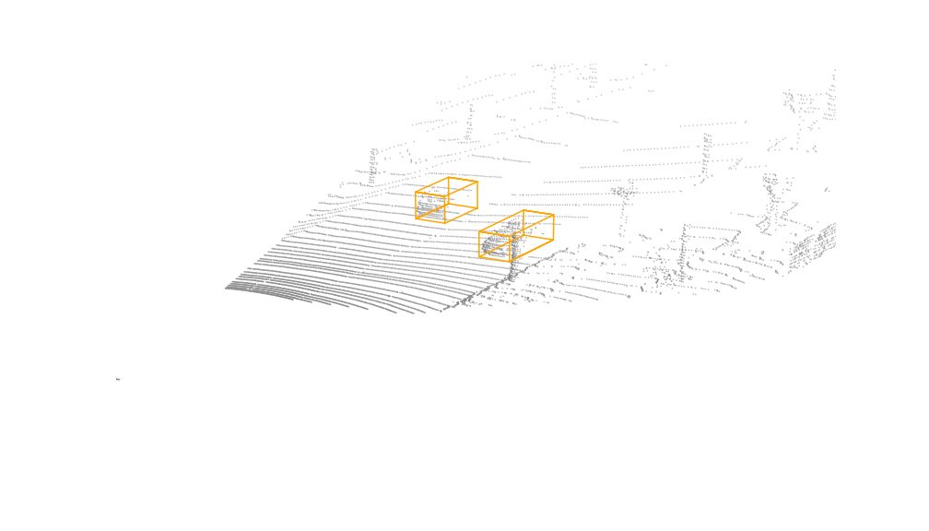
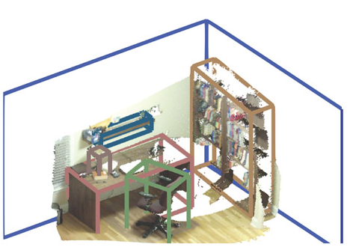
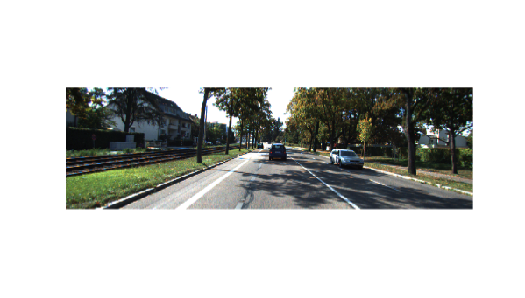

3D Object Localization
3D vehicle detection (outdoor, KITTI)
3D object detection (indoor, SUN RGB-D)
3D Bounding Box in Global Context
3D Bounding Box in Global Context
3D Bounding Box in Global Context
Camera Coordinate frame
Camera Coordinate frame

Slide 3
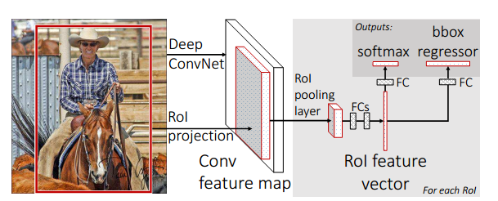
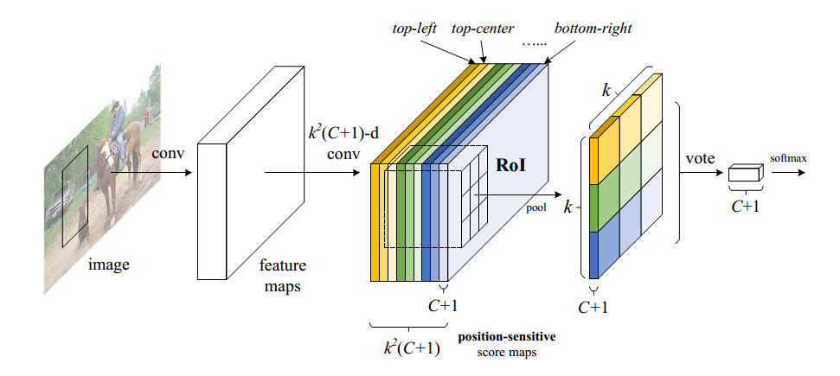
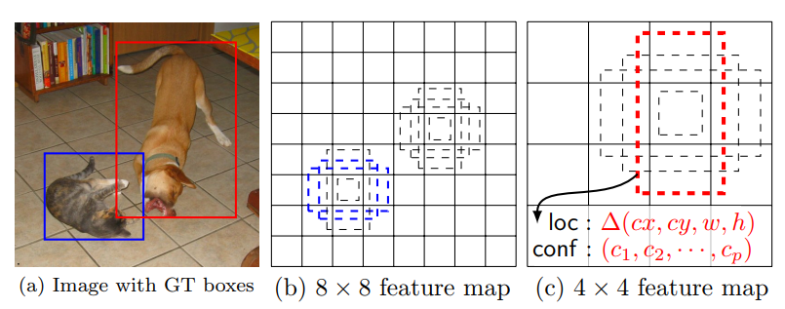
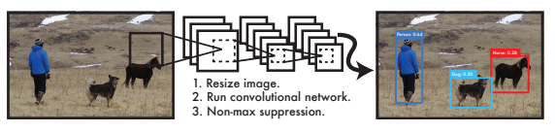
Related Work: 2D Object Detection
Two-stage methods
One-stage methods
Faster R-CNN (Ren et al, 2015)
R-FCN (Dai et al, 2016)
YOLO (Redmon et al, 2015)
SSD (Liu et al, 2015)

Slide 4
Related Work: Monocular 3D Object Detection
Mono3D (Chen et al, 2016)
Exploits segmentation and context priors to generate 3D proposals
Uses extra networks for semantic and instance segmentation are required
MF3D (Tung et al, 2017)
Uses a pretrained disparity estimation model to predict pixel-level depth from a single RGB image to guide 3D inference
DeepManta (Chabot et al, 2017)
Utilizes 3D CAD models to generate synthetic data for training
All previous methods exploit additional data and networks to facilitate the 3D perception, while our method only requires annotated 3D bounding boxes and no extra network needs to train.

Slide 5




Mono-GRNet: Geometric Reasoning Network
backbone
Legend
Input Image (RGB)
2D BBox
Conv
FC
Output
Add
Coordinate transform
RoiAlign
Local corner offsets
Early features
RoiAlign
Delta 3D Location
3D Bounding Box in Global Context
Depth Convs
RoiAlign
Delta Instance Depth
Refined 3D Location
Refined Instance Depth
Deep features
Depth Convs
Coarse Instance Depth
Coarse 3D Location
Projected 3D Center
2D detection
Instance depth estimation
3D center localization
Local corners regression
Notes:
Teichmann, M, et al, Multinet: Real-time joint semantic reasoning for autonomous driving

Slide 6


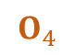





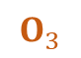
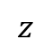

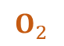
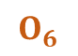
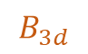
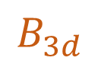
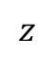
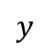


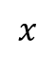
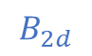
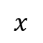

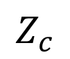

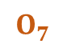


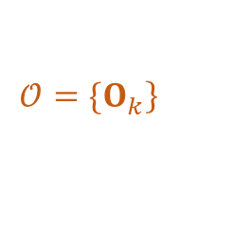
Targets
$$Z_{c}$$
Instance depth
Projected 3D center
Local corners
3D location
$$C$$
$$c$$
3D Bounding box
$$B_{3d}$$
$$\left.𝒪=\{O_{k}\right\}$$
3D BBox
$$B_{3d}$$
Local corners
$$\left.𝒪=\{O_{k}\right\}$$
2D BBox
$$B_{2d}$$
$$O_{7}$$
$$O_{6}$$
$$z$$
$$z$$
$$y$$
$$c$$
$$C$$
$$x$$
$$O_{4}$$
$$x$$
$$O_{8}$$
$$O_{3}$$
$$b$$
Camera
$$x$$
$$O_{5}$$
$$z$$
Bird’s eye view
$$O_{1}$$
$$O_{2}$$
$$y$$
Image plane
$$x$$
Camera
$$z$$
(a) 2D Projection
(b) Camera coordinate frame
(c) Local coordinate frame

Slide 7
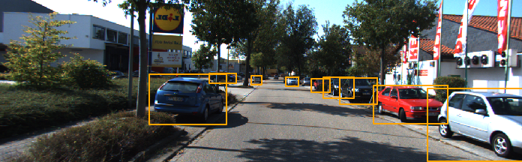


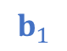
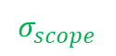
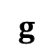
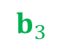
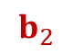
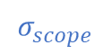
Instance Depth Estimation
$$σ_{scope}$$
Input image with 2D bounding box
$$b_{2}$$
$$g$$
$$b_{3}$$
$$b_{1}$$
$$σ_{scope}$$
$$σ_{scope}$$
Scopes of instances on grid cells
Instance depth map
(each cell predicts the central depth of its assigned instance)

Slide 8

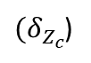
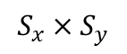
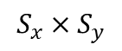
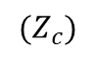
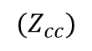
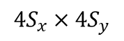
Instance Depth Estimation Subnetwork
Similar architecture for other subnetworks
2D BBox
Image with
$$S_{x}×S_{y}$$
Grid
Feature map
Conv
Depth Encoder
RoiAlign
fc
Depth Delta
$$4S_{x}×4S_{y}$$
${(δ}_{Z_{c}}$)
Refined Depth
Conv
Grid cell
$${(Z}_{c})$$
Depth Encoder
fc
Coarse Depth
$$S_{x}×S_{y}$$
$$(Z_{cc})$$

Slide 9
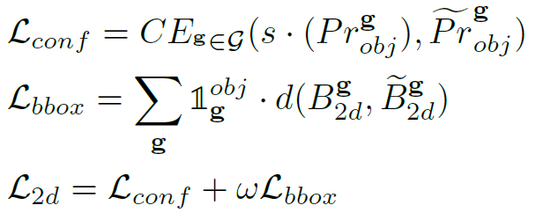
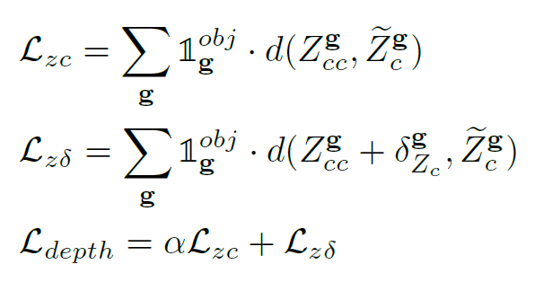
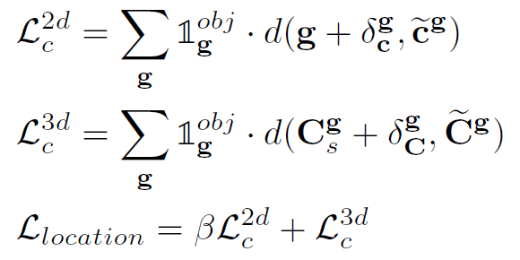
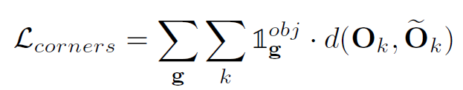
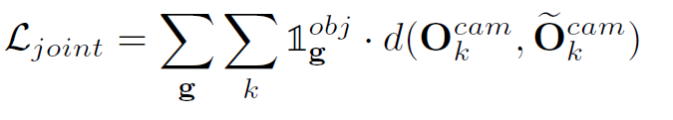
Loss Functions
Subnetwork Losses
2D Detection Loss
Instance Depth Loss
3D Localization Loss
Local Corner Regression
Final joint 3D loss (in camera coordinate frame)

Slide 10
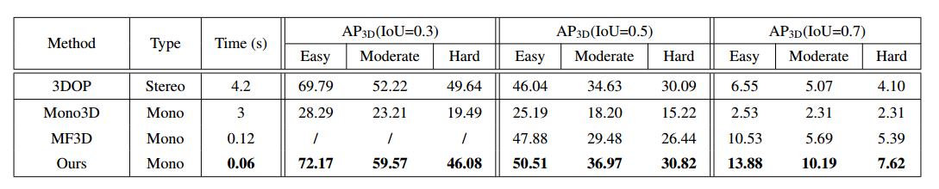
Results
Tested on KITTI dataset for 3D car detection
State-of-the-art monocular methods
Comparable to stereo-based methods
3D Detection Performance. Average Precision of 3D bounding boxes on the same KITTI validation set and the
inference time per image. Note that the stereo-based method 3DOP is not compared but listed for reference.
Notes:
00000000000000089

Slide 11
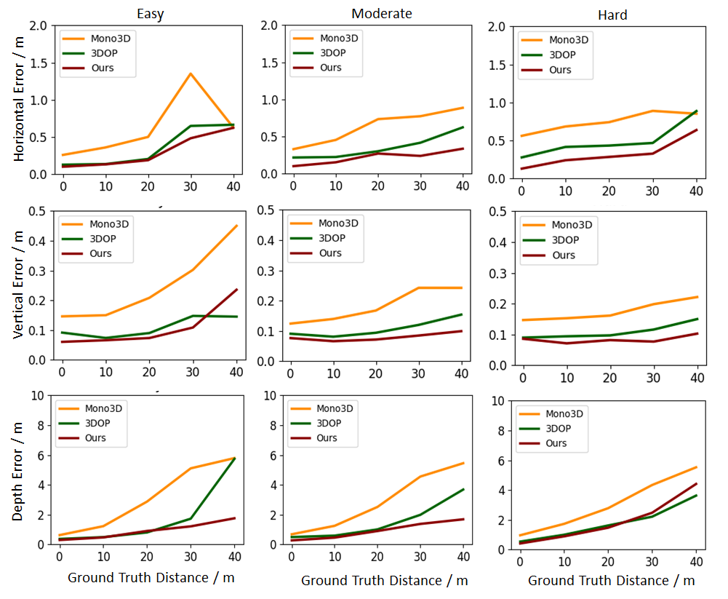
Results
3D localization errors in three dimensions according to the distances between objects and camera centers

Slide 12
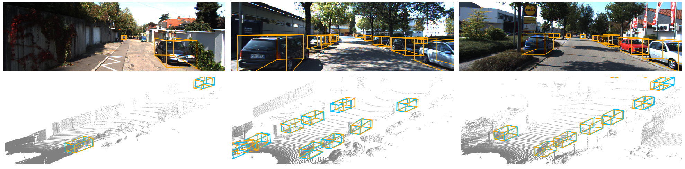
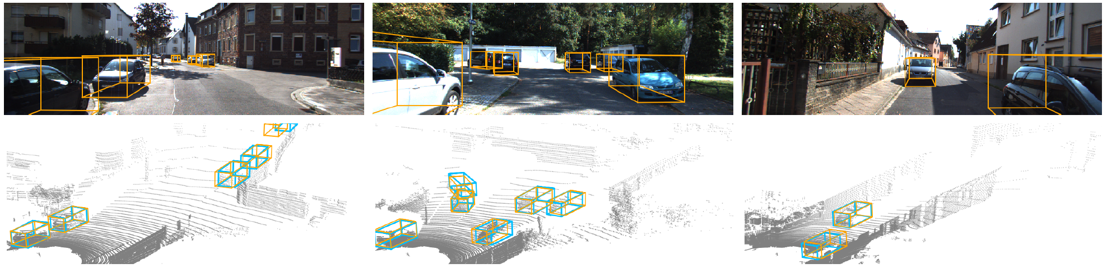
Results
Qualitative Results. Orange box denotes prediction and blue box denotes ground truth

Slide 13
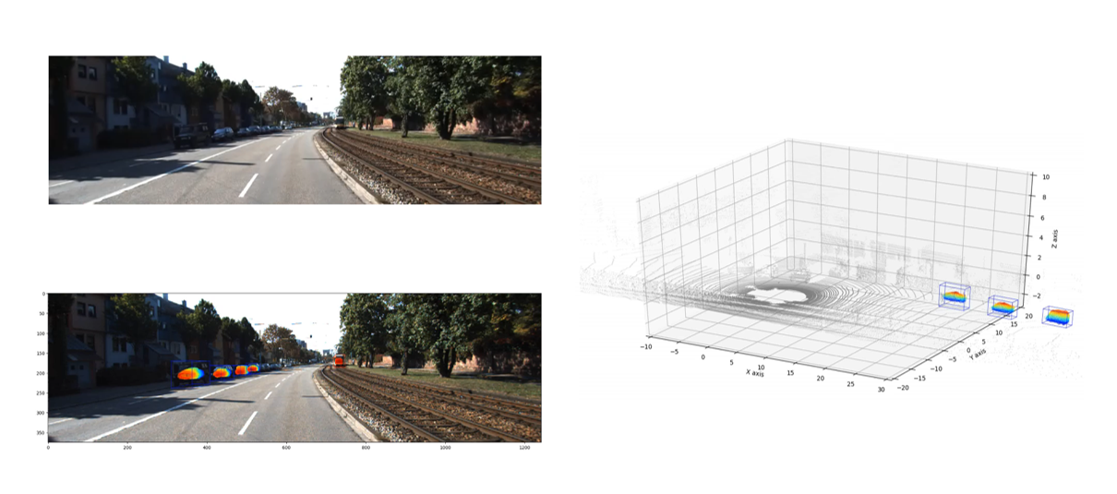
Video Demo: 3D Localization
We’ll add the video demo in the final presentation

Slide 14
Conclusions
A novel instance-level depth estimation approach that directly predicts central depths of ABBox-3D in the absence of dense depth data, regardless of object occlusion and truncation.
A progressive 3D localization scheme that explores rich feature representations in 2D images and extends geometric reasoning into 3D context.
A unified network that coordinates localization of objects in 2D, 2.5D and 3D spaces via a joint optimization, which performs efficient inference (taking ∼0.06s/image).

Slide 15
Thank you!

